Slide 1
Flood Protection Structure Accreditation Task Force
Jason Needham, USACE
May 2013
Notes:
FEMA
Introduce self
A number of things going on in the levee arena (not identified the #1 Risk MAP risk for nothing)
LAMP
NAS
Levee Accreditation Task Force
LAMP Status
Final Concurrence of Approach Doc
Congressional Briefing
Training Classes
G&S
1st Wave
NAS: awaiting report
Today’s focus is the Levee Accreditation Task Force
Task Force between FEMA and USACE with assistance from the NCLS
Introduce Geoff Henggeler, USACE

Slide 2
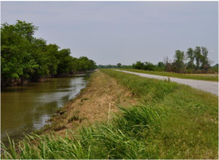
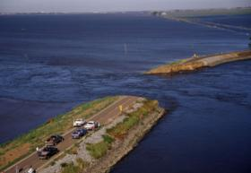
FEMA-USACE Task Force (MAP-21)
Through Section 100226, FEMA and USACE are: …directed to convene a joint task force with USACE to “better align information and data collected” under ICW with NFIP levee accreditation so that
Data can be used interchangeably.
Information collected for ICW is sufficient to satisfy accreditation.
Notes:
FEMA
Biggert Waters 2012 (BW12), or MAP-21 as it is also known said the following.
While #1 seems perfectly doable, #2 is a serious lift.
Recommendations will outline how this can be accomplished while also retaining role of communities and levee owners/sponsors
Other important note is that even in those communities where we cannot meet the full intent of #2, we plan to make the best progress in that direction as we can (will outline that for you)

Slide 3
How Does a Levee System get Accredited?
Levee certification/accreditation: the process of compiling the data and analysis to provide to FEMA to demonstrate 44 CFR 65.10 is met.
Notes:
3
FEMA
Certification and Accreditation are often confused
Levee Certification: process of compiling the data and analysis to demonstrate compliance with 65.10
Levee Accreditation: process of FEMA receiving and acknowledging a 65.10 package is complete and reflecting on the map (PM 63)
Flow chart shows full process
***Task Force is focused on 3rd item
Data collection
Analysis
Data sharing
Does not address/propose to change what FEMA does with the data (accreditation process)

Slide 4
44 CFR 65.10 Requirements
44 CFR 65.10 | General Requirement Description
Design Criteria
65.10(b)(1) | Freeboard (Levee Height)
65.10(b)(2) | Closures
65.10(b)(3) | Embankment Protection
65.10(b)(4) | Embankment and Foundation Stability Analyses (including seepage)
65.10(b)(5) | Settlement Analyses
65.10(b)(6) | Interior Drainage Analysis and Mapping
Operations Plans and Criteria
65.10(c)(1) | Closures – Operation Plans and Criteria - (includes sub-items)
65.10(c)(2) | Interior Drainage Systems – Operation Plans and Criteria (includes sub-items)
Maintenance Plans and Criteria
65.10(d) | Maintenance Plans and Criteria
Certification of Package
65.10(e) | Certification Requirements, As-Built drawings, etc.
Notes:
FEMA
Full list of 65.10 items
Often 65.10 (b) requirements are where communities get stuck
What I wanted to stress here for this group is 65.10 (e)
Here is where we have flexibility in 65.10 (b) requirements
In lieu of these structural requirements (b), a
Federal agency with responsibility for
levee design may certify that the levee
has been adequately designed and constructed
to provide protection against
the base flood.
With the release of their Engineering Circular 6067 the USACE has been requiring their offices to submit all the technical data to support a positive finding, all we need is their statement

Slide 5
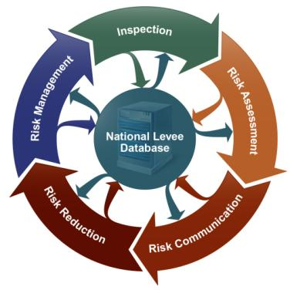
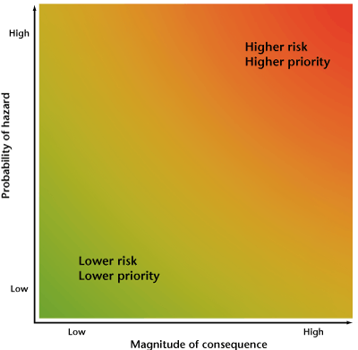
USACE Levee Safety Program
Recurring activities that include a visual observation of levee conditions and verification that levee sponsor is properly operating and maintaining a levee.
Screenings and “Risk Assessments”
Notes:
USACE Levee Activities
March 2008
USACE Activities-5
Risk informed
Extensive stakeholder involvement
Urgency of actions commensurate with risk

Slide 6
Where We Are Now
CURRENT ALIGNMENT DATA CONTRIBUTION
Inspection Data
USACE
Screening Data
Risk Assessment Data
Accreditation Request
Package Submission
Sponsor/FEMA
Accreditation Request Data

Slide 7
Alignment of Inspection Data
PROPOSED ALIGNMENT DATA CONTRIBUTION (not to scale)
Scenario 1: Inspection Data
USACE
Accreditation Request
Package Submission
Sponsor/FEMA
Accreditation Request Data
Performance Modes Observable* During an Inspection |  | Performance Modes that Require Analysis to Assess
Erosion | Damage or Defects | Piping of Substratum | Overtopping

Slide 8
Alignment of Screening Data
PROPOSED ALIGNMENT DATA CONTRIBUTION (not to scale)
Scenario 1: Inspection Data
USACE
Scenario 2: Screening Data
Accreditation Request
Package Submission
Sponsor/FEMA
Accreditation Request Data

Slide 9
Inspections + Screenings + Risk Assessment
PROPOSED ALIGNMENT DATA CONTRIBUTION (not to scale)
Scenario 1: Inspection Data
USACE
Scenario 2: Screening Data
Scenario 3: Risk Assessment Data
Accreditation Request
Package Submission
Sponsor/FEMA
Accreditation Request Data

Slide 10
Risk Assessments
Analysis covering a range of flood events and expected levee performance
Systematic and repeatable
Takes into consideration various data sources that deterministic approaches do not: i.e. historic performance
Includes assessment of consequences of leveed area inundation

Slide 11
Why Risk Assessments?
Results provide information for making risk management decisions
Results include identification of risk drivers – this assists in prioritizing actions and determining sense of urgency
Often allows decisions to be made based on less information and data than would be necessary for traditional approaches

Slide 12
Summary
Community/sponsor has decision whether to participate in National Flood Insurance Program.
Has a key role in the accreditation process.
USACE inspections and screenings do not collect all the information required for 44 CFR 65.10.
Direct links will be assessed and communicated more often. Includes information that a levee may no longer meet a criteria in 44 CFR 65.10.
Risk assessments will be the methodology used by USACE for accreditation decisions.
Notes:
FEMA
Again communities have a responsibility in meeting accreditation
Inspections and Screenings to not meet 65.10
Looking for better linkages, and removal of duplication
Risk Assessments are our proposal to close gap

